Slide 1



216U06C105 – Engineering Drawing
Module - I
FY Div-C5
Sheba Varghese
Assistant Professor
Department of Mechanical Engineering
Room – A310
e-mail – sheba@somaiya.edu

Slide 2

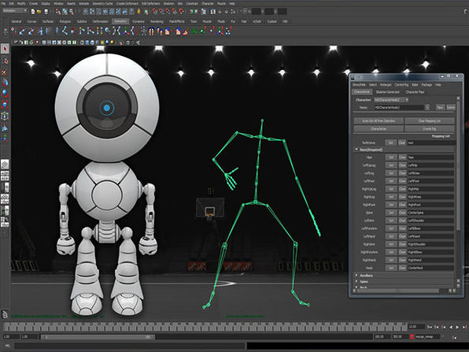
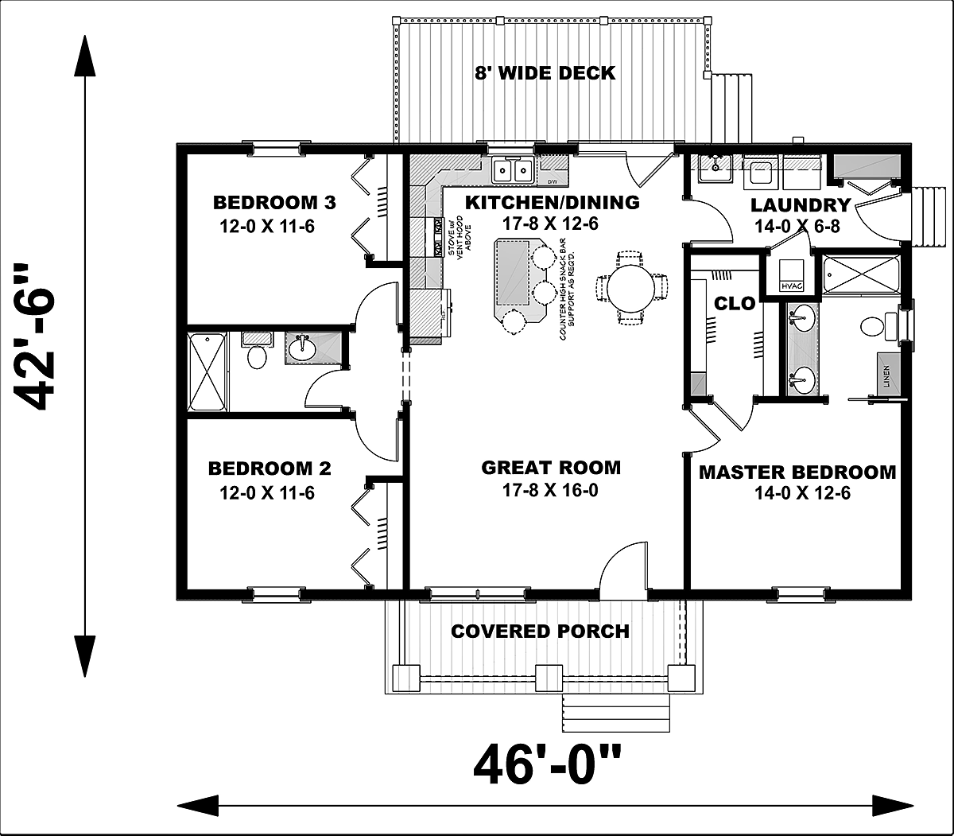

Why is this course IMPORTANT !!

Slide 3

What you will learn ?

Slide 4
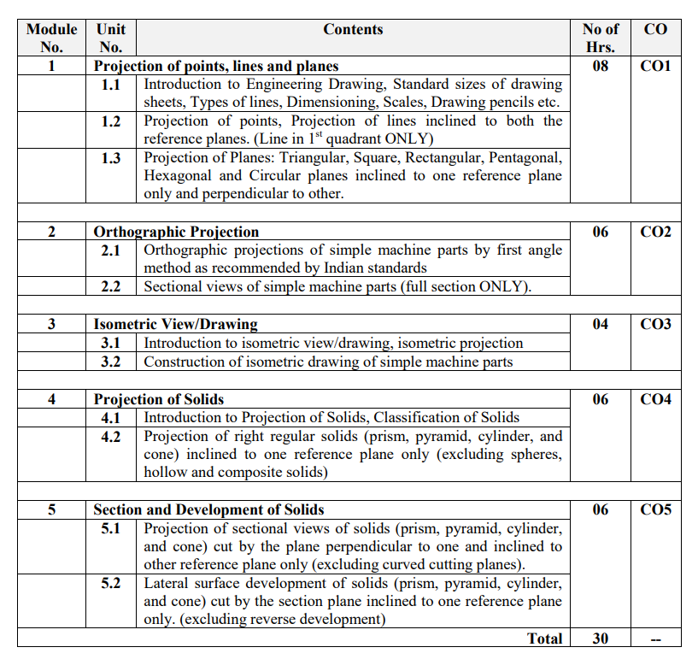


Slide 5
Engineering Drawing Syllabus !!
Mod. I
Types of lines, Dimensioning, Drawing Sheets, Scales, Pencils etc.
Projection of points and Projections of lines inclined to both planes
Projection of Planes: Triangular, Square, Rectangular, Pentagonal, Hexagonal and circular planes inclined to one reference plane and perpendicular to other.
Mod. II
Orthographic projections of simple machine parts by first angle method as recommended by Indian standards, Sectional views of simple machine parts (full section)
Mod. III
Introduction to Isometric drawing and construction of isometric drawing of machine parts
Mod. IV
Introduction to Projection of Solids, Classification of Solids and Projection of right regular solids (prism, pyramid, cylinder, and cone) inclined to both reference planes (excluding spheres, hollow and composite solids)
Mod. V
Projection of sectional views for solids (prism, pyramid, cylinder, and cone) cut by plane perpendicular to one and inclined to other reference planes (excluding curved cutting planes).
Lateral surface development of prism, pyramid, cylinder, cone with section plane inclined to one reference plane only. (excluding reverse development)

Slide 6
Course Pre-requisites
 | Knowledge of Various geometric constructions, Basics of trigonometry

Slide 7
Course Objectives
Course Outcomes | After successful completion of the course students should be able to:
1 | Familiarize with the conventions and standards along with the principles of projections applied to lines and points
2 | Apply the principles of orthographic projections to draw elevation, plan, End view, Isometric views etc.
3 | Apply the principles of orthographic projections to draw to draw various views of regular solid objects
4 | Apply the fundamentals of solid geometry and develop lateral surfaces of solids

Slide 8
Course Outcomes
Course Outcomes | After successful completion of the course students should be able to visualize and draw :
CO1 | Projection of lines and planes
CO2 | Orthographic and sectional views of any 3D object
CO3 | Isometric drawing
CO4 | Projection of regular solids
CO5 | Section and lateral development of regular solids

Slide 9
References
Name/s of Author/s | Title of Book | Name of Publisher with country
N.D. Bhatt | Engineering Drawing (Plane and solid geometry) | Charotar Publishing House Pvt. Ltd
N.D. Bhatt V.M. Panchal | Machine Drawing | Charotar Publishing House Pvt. Ltd
P. S. Gill | Engineering Graphics and Drafting | S.K. Kataria & Sons
P.J. Shah | Engineering Graphics | S. Chand Publications
Dhananjay Jolhe | Engineering Drawing | Tata McGraw Hill

Slide 10
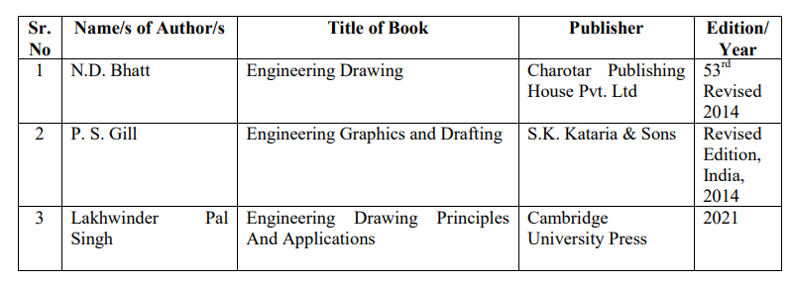
References

Slide 11
Scheme
Course Code | Course Title
216U06C105 | Engineering Drawing
 | TH |  |  | P |  | TUT |  | Total
Teaching Scheme(Hrs.) | 02 |  |  | -- |  | 01* |  | 03
Credits Assigned | 02 |  |  | -- |  | 01 |  | 03
Examination Scheme | Marks
 | CA |  | ESE | TW | O |  | P&O | Total
 | ISE | IA
 | 30 | 20 | 50 | -- | -- |  | -- | 100
* Batch wise Tutorial

Slide 12
Things to Note!!!
Please check your LMS regularly for announcements
Always sit for the lecture with an unruled book and drawing instruments
Be NEAT in your drawings !
Tutorial submissions should be done on a separate A3 sized drawing book
Follow the instructions given in the LAB during ED Lab hours
Timely submissions is required and be regular in attending lectures.
Failure of submitting Term Work – YOU LOOSE A YEAR !!

Slide 13
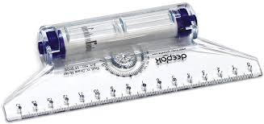
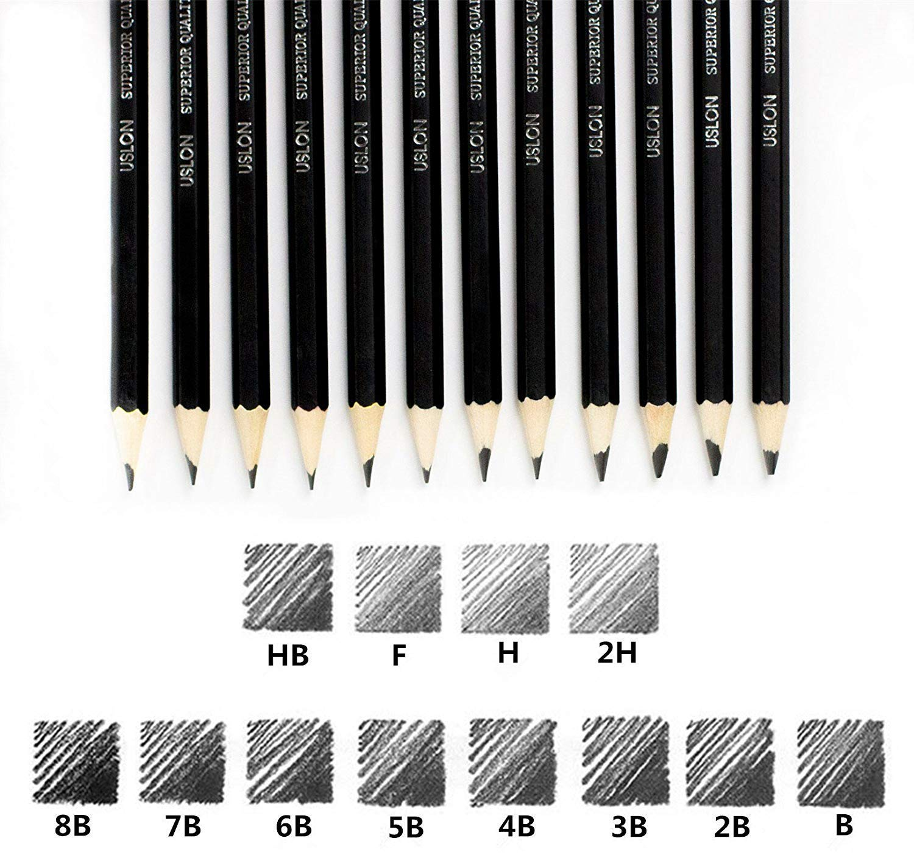
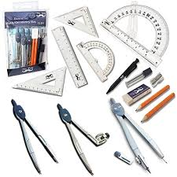

Drawing Instruments and Accessories

Slide 14
Types of lines

Slide 15
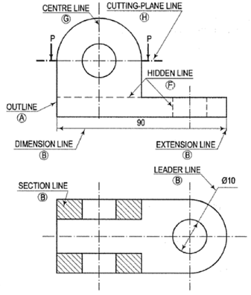
Type of lines !!

Slide 16
Type of lines !!

Slide 17
Dimensioning

Slide 18
Aligned and Unidirectional System

Slide 19
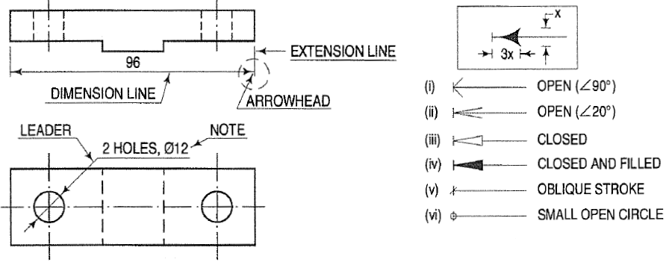
Dimension lines Vs Extension lines

Slide 20
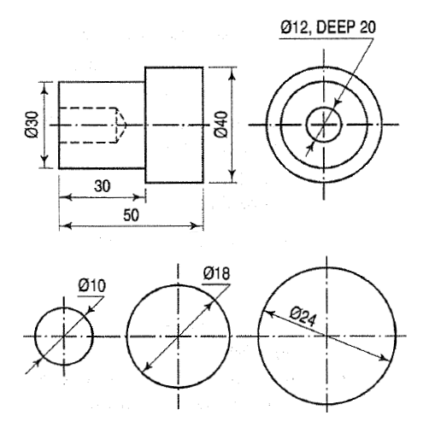
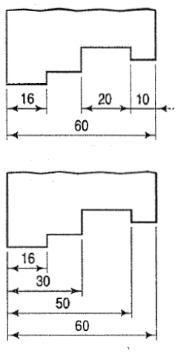
Ways to dimension features !

Slide 21
Ways to dimension features !

Slide 22
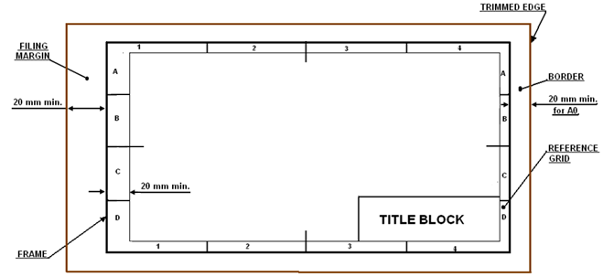
Drawing sheet layout and size

Slide 23
Scales

Slide 24
SCALES
Scaling is used for shrinking a large object on paper
OR
To enlarge an object which otherwise is too small to draw on the paper.

Slide 25
Projection of Points

Slide 26
What is Projection ?
In engineering, 3-dimensonal objects and structures are represented graphically on a 2-dimensional media. The act of obtaining the image of an object is termed “projection”. The image obtained by projection is known as a “view”. A simple projection system is shown in figure .
All projection theory are based on two variables:
Lines of projection (sight): It is an imaginary ray of light between an observer’s eye and an object.
Plane of projection: It is an imaginary flat plane which the image is created.

Slide 27
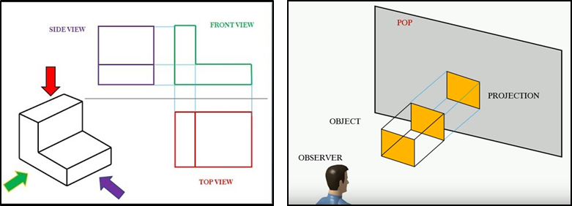
What is Projection ?
Orthographic Projection: The projection in which the projectors are parallel to each other and perpendicular to the plane

Slide 28
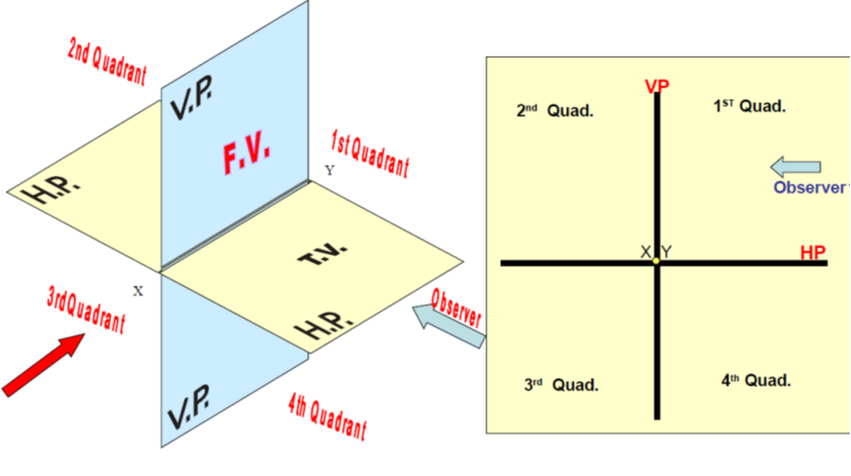
Quadrant System

Slide 29
Quadrant System
First Quadrant

Slide 30
Projection of Points in various Quadrants
Second Quadrant
Third Quadrant
Fourth Quadrant

Slide 31
Special Cases

Slide 32
Problems
A Point A is 20 mm below HP and 30 mm behind VP. Draw its projections

Slide 33
Problems

Slide 34
Projection of Lines

Slide 35
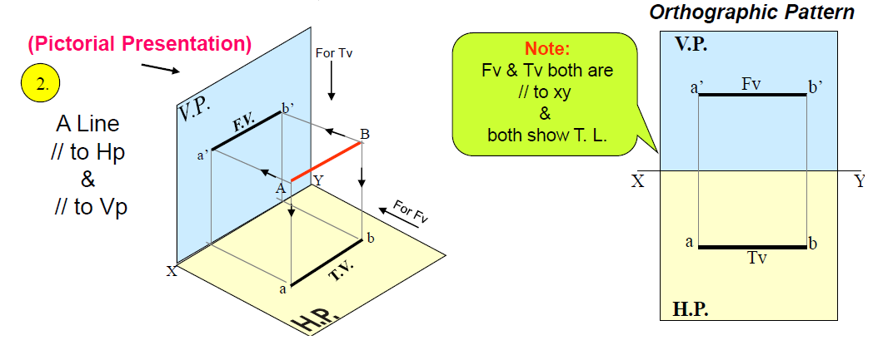

Line in First Quadrant – Case I

Slide 36

Line in First Quadrant – Case II

Slide 37
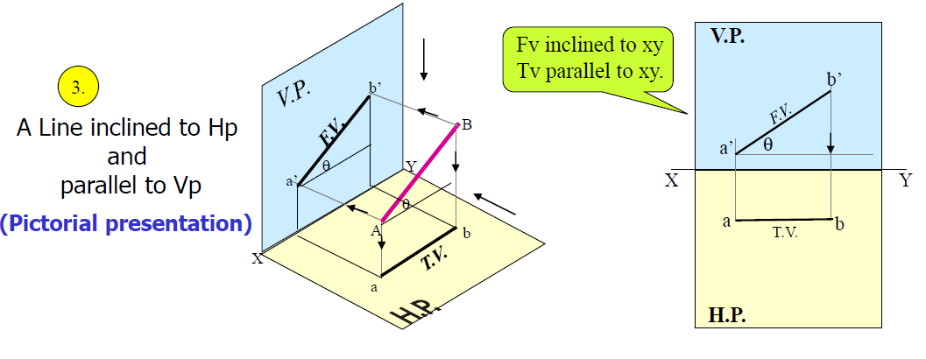
Line in First Quadrant – Case III

Slide 38
Line in First Quadrant – Case IV

Slide 39
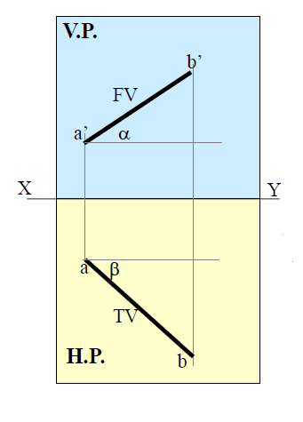
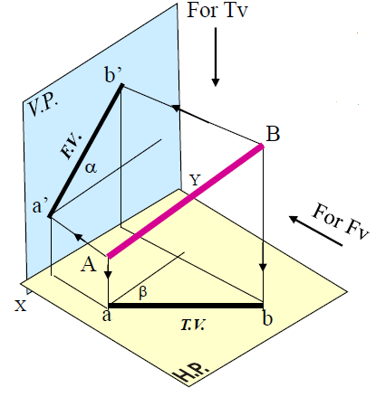
Lines inclined to both planes !
Are the angles shown here the real inclinations ?
What about the true length of the line ?
How to find the true length and inclinations of the line ?

Slide 41
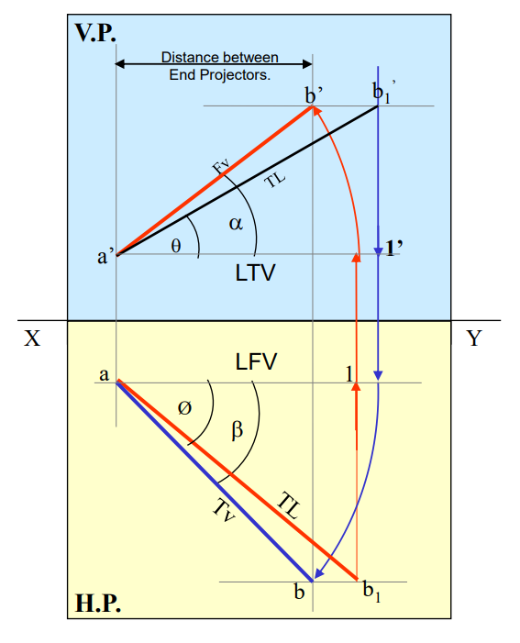
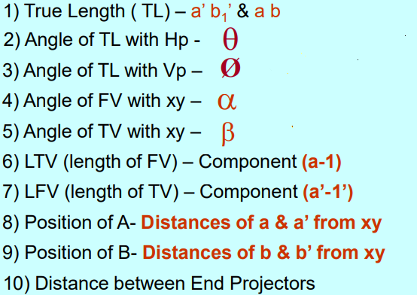

Slide 42
Lecture 8 : Date 31-08-2023
Topic: Problems on Lines inclined to both planes

Slide 43
Q1. The F.V and T.V of the line PQ measures 50 mm and 60 mm respectively. The line is 75 mm long. Point P is 35 mm above H.P. and 15 mm in front of V.P. Draw the projections of the line PQ and determine its inclinations with the H.P and V.P. Assume the line to be in 1st quadrant.
Q2. Line AB is 75 mm long makes 45º inclination with VP while its FV makes 55º. End A is 10mm above HP and 15 mm in front of VP. If the line is in the first Quadrant, draw the projections and find its inclination with HP.

Slide 44
Lecture 9 : Date 1-09-2023
Topic: Problems on Lines inclined to both planes

Slide 45
Q3. The plan length of the line AB, 70 mm long measures 50 mm. The end point A is 50 mm in front of V.P and 15 mm above the H.P. The end B is 15 mm in front of V.P and above the H.P. Draw the projections of the line AB and determine its inclinations with H.P and V.P
Q4. A line AB, 90 mm long has its one end A in the H.P. and 35 mm behind V.P and the other end B in V.P and 55 mm below H.P. Draw the projections of the line and find its inclinations with H.P and V.P.

Slide 46
Lecture 10 : Date 05-09-2023
Topic: Practice problems on Lines inclined to both planes

Slide 47
Problems
b`
b`₁
Line AB is 75 mm long and it is 30º and 40º inclined to HP and VP respectively. End A is 12mm above HP and 10 mm in front of VP. Draw the projections. Assume line is in the first quadrant.
FV
TL
θ
a`
X
Y
Given Data:
TL
True inclinations to HP and VP (θ and ϕ)
Position of point A wrt. HP and VP
a
LFV
Ø
1
TV
TL
b
b₁

Slide 48
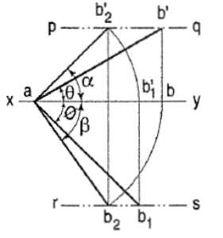
Problems
A line AB, 50 mm long has its end A in both HP and VP. It is inclined at 30º to HP and 45º to VP. Draw the projections.
Given Data:
TL
True inclinations to HP and VP (θ and ϕ)
Position of point A wrt. HP and VP

Slide 49
Problems
LOCUS OF b₁’
b’
b’₁
Line AB is 75 mm long makes 45º inclination with VP while its FV makes 55º. End A is 10mm above HP and 15 mm in front of VP. If the line is in the first Quadrant, draw the projections and find its inclination with HP.
FV
TL
55⁰
a’
X
Y
a
LFV
1
Given Data:
TL
True inclinations to VP (ϕ)
Apparent inclination with HP (α)
Position of point A wrt. HP and VP
Φ 45⁰
TV
TL
LOCUS OF b
b
b₁

Slide 50
Problems
b’
b’₁
FV of line AB is 50⁰ inclined to XY and measures 55 mm long while it’s TV is 60⁰ inclined to XY line. If end A is 10 mm above HP and 15 mm in front of VP, draw it’s projections, find TL, inclinations of line with HP & VP.
FV
TL
50⁰
θ
X
a’
Y
a
Given Data:
FV
Apparent inclinations to VP (ϕ)
Apparent inclination to HP (β)
Position of point A wrt. HP and VP
Φ
60⁰
TL
b₁
b

Slide 51
Problems
The top view of a 75 mm line AB measures 65 mm, while its front view measures 50 mm. Its one end A is in HP and 12 mm in front of VP. Draw the projections of AB and determine its inclination with HP and VP.
Given Data:
TV and TL
FV
Position of point A wrt. HP and VP

Slide 52
Problems
The top view of a 75 mm line AB measures 65 mm, while its front view measures 50 mm. Its one end A is in HP and 12 mm in front of VP. Draw the projections of AB and determine its inclination with HP and VP.
Given Data:
TV and TL
FV
Position of point A wrt. HP and VP

Slide 53
Problems
A line AB is 65 mm long has its end A 20 mm above HP and 25 mm in front of VP. The end B is 40 mm above HP and 65 mm in front of VP. Draw the projections of AB and show its inclination with HP.
Given Data:
TL
Position of point A and B wrt. HP and VP

Slide 54
Line in two quadrants

Slide 55
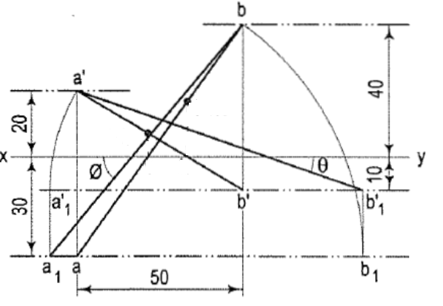
Problems
The projectors of the ends of a line AB are 50 mm apart . The end A is 20 mm above the HP and 30 mm in front of the VP. The end B is 10 mm below the HP and 40 mm behind the VP. Determine the true length and its inclinations with the two planes.
Given Data:
Distance between end projectors
Position of point A wrt. HP and VP
Position of point B wrt. HP and VP

Slide 56
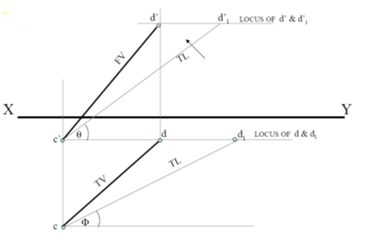
Problems
The top view of a 75 mm long line CD measures 50 mm. The end C is 15 mm below HP and 50 mm in front of VP. End D is 15 mm in front of VP and it is above HP. Draw the projections of CD and find angles with HP and VP
Given Data:
TL, TV
Position of point C wrt. HP and VP
Position of point D wrt. VP

Slide 57
Problems
End A of a line AB is in HP and 25 mm behind VP. End B is in VP and 50 mm above HP. Distance between the end projectors is 70 mm. Draw the projections and find the angles made by the line with HP and VP.
Given Data:
TL, TV
Position of point C wrt. HP and VP
Position of point D wrt. VP

Slide 58
Thank you !!

